Slide 1
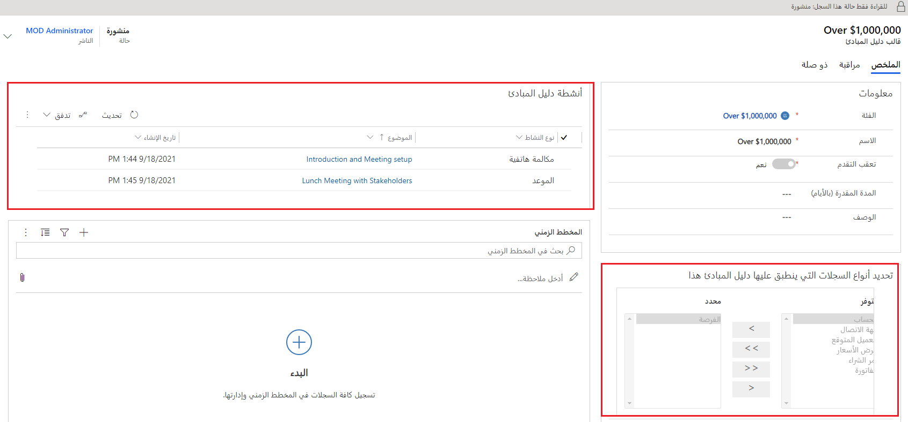
يُحدد إذا ما كان التقدم الإجمالي متعقب، ومكان إنشاء الأنشطة المرتبطة.
يُحدد الأنشطة التي سيتم إنشاؤها عند تطبيق دليل المبادئ.
يُمكن تطبيق دليل مبادئ المبيعات على العديد من الكيانات.

Slide 2
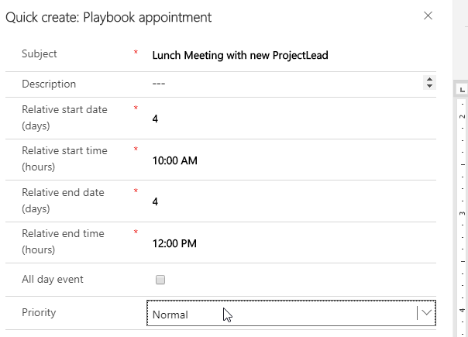

Slide 3
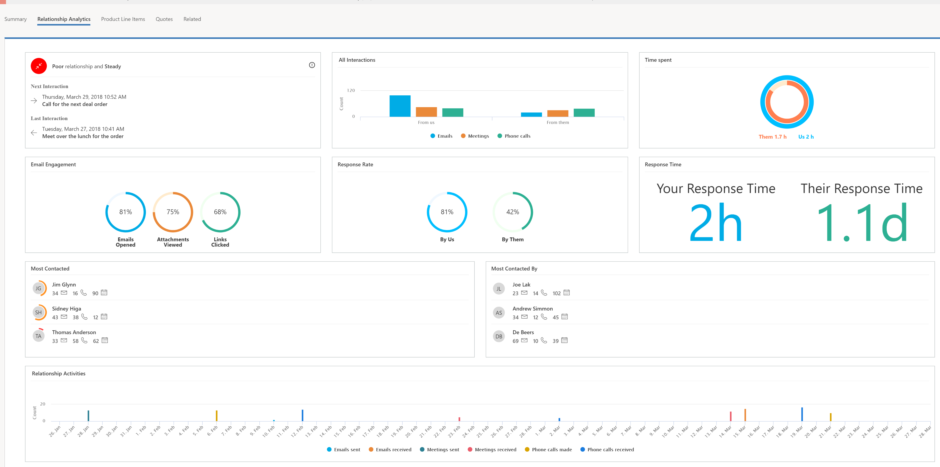
1
4
5
2
3
Relationship analytics provides an activity history, KPIs, health score, and health trend for contact, opportunity, lead, and account records. The most important KPIs (including your team's previous and next activity) are shown in the list view for each of these record types, so you can get an overview and sort the list by them
Relationship analytics provides an activity history, KPIs, health score, and health trend for contact, opportunity, lead, and account records. The most important KPIs (including your team's previous and next activity) are shown in the list view for each of these record types, so you can get an overview and sort the list by themRelationship analytics provides an activity history, KPIs, health score, and health trend for contact, opportunity, lead, and account records. The most important KPIs (including your team's previous and next activity) are shown in the list view for each of these record types, so you can get an overview and sort the list by them
8
6
7
9
10
11

Slide 4
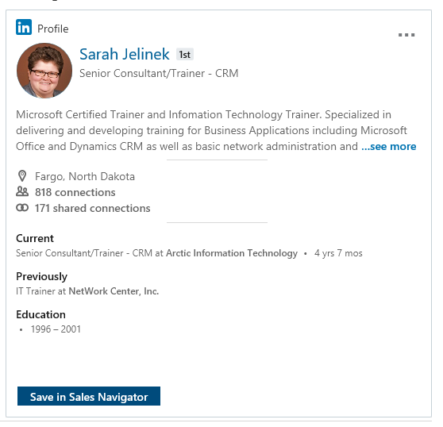


Slide 5

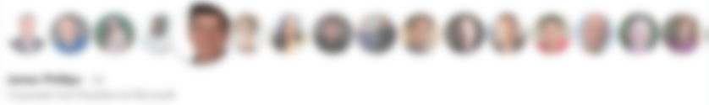

Slide 6
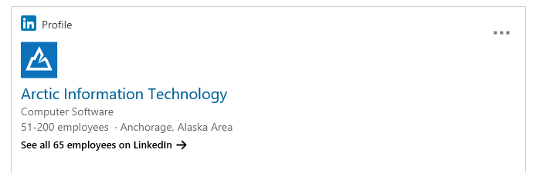


Slide 7
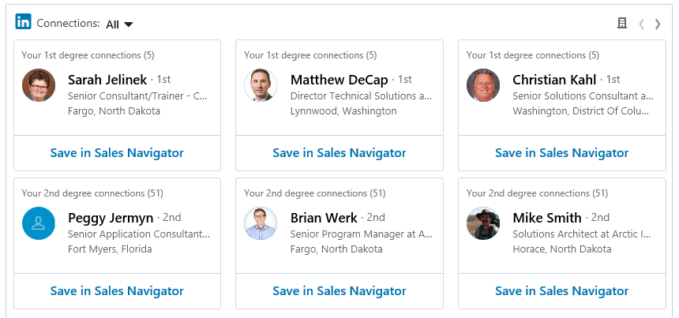
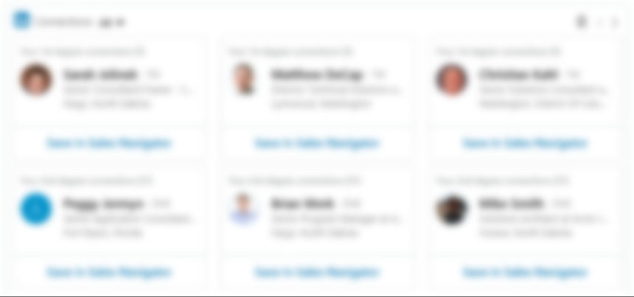

Slide 8
